Slide 1





Summary of mini-demonstrators

Slide 2
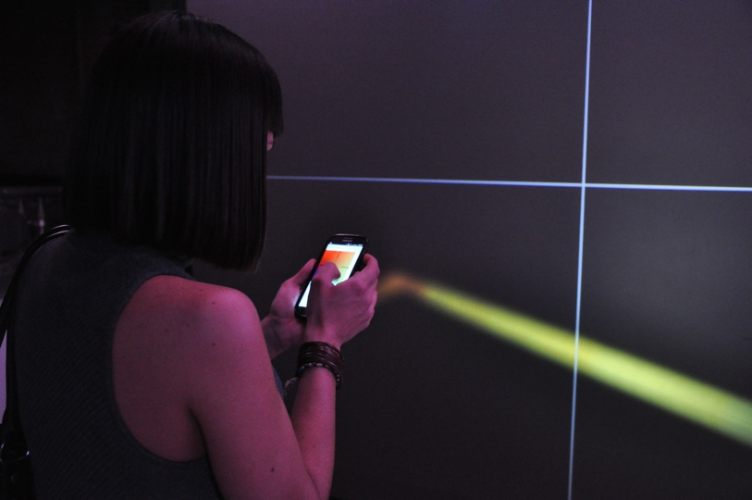
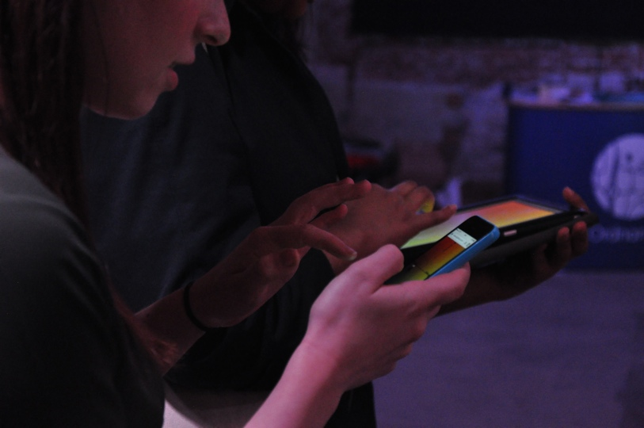
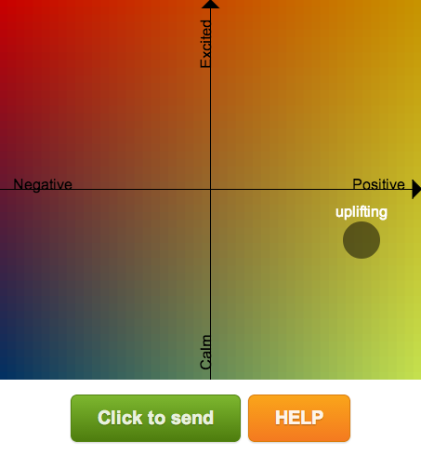
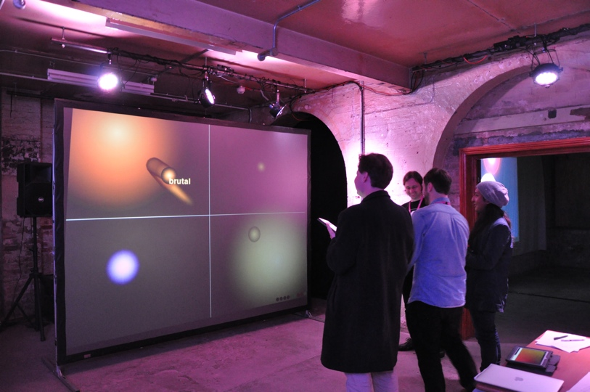
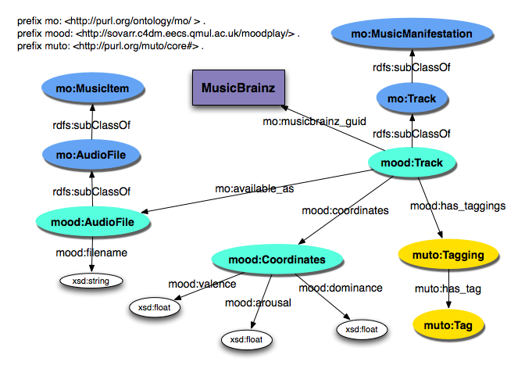



Moodplay: a semantic mood-based collaborative jukebox
Mathieu Barthet, György Fazekas, Alo Allik, James Woodbridge
Moodplay allows users to collectively select music and control lighting effects conveying desired emotions.
The system combines audio and semantic web technologies to provide personalised and interactive musical experiences.
In order to vote for the music, participants can choose degree of energy and pleasantness (Arousal-Valence) using our Mood Conductor web app.
The audio client queries mood coordinates and track metadata from a triple store using a SPARQL endpoint.
The mood metadata is crowd-sourced from Last.FM tags and converted to Arousal-Valence coordinates using the Affective Circumplex Transform.

Slide 3
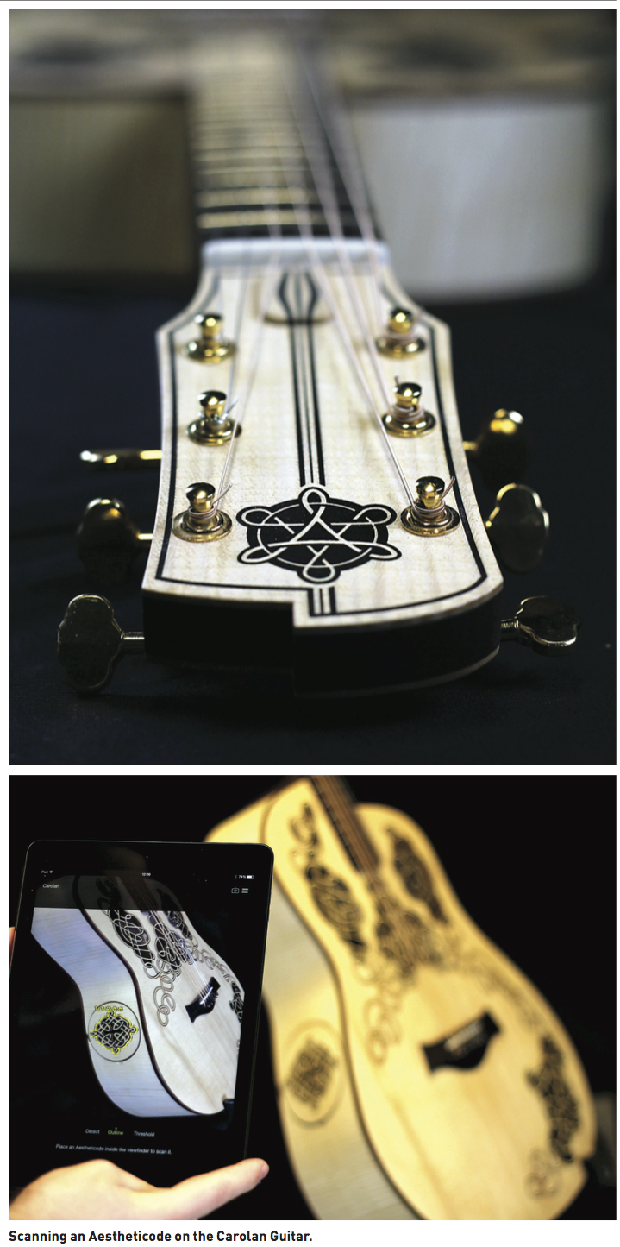
Augmenting Instruments
Carolan guitar ‘On the Road ‘15’
Studies of Use – Scoping
Augmenting, Sensing and Capturing
Performing, Studios and Liveness
At Performing Data, WOMAD and NIME 2015
Catalyst for Design – DMO, Extraction, Learning, Practice & Consumption

Slide 4
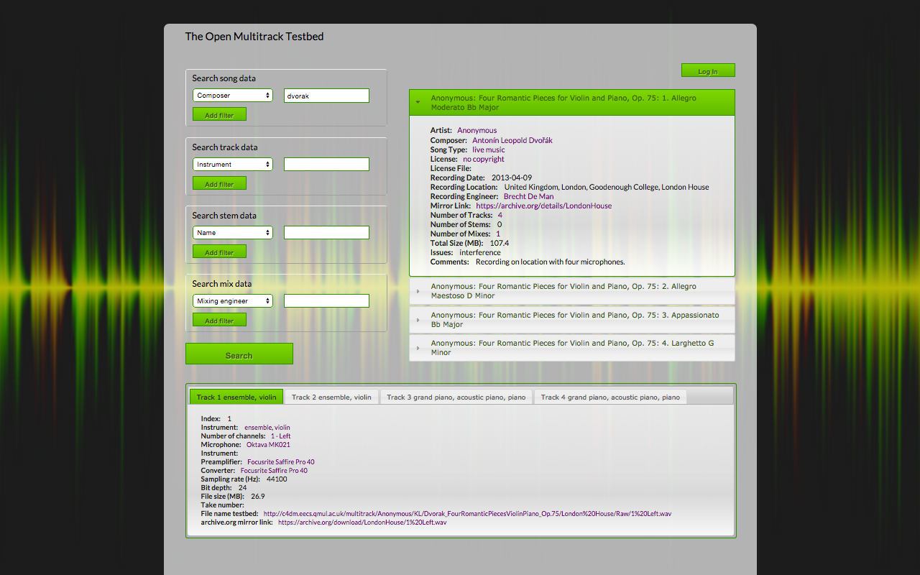

Multitrack testbed
A database of semantically linked metadata about audio recordings
Users can input, search and browse linked data
Faceted search and data display through various categories
User-restricted data

Slide 5
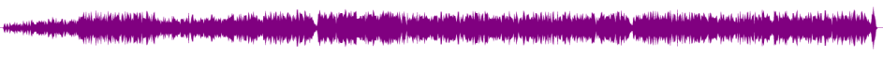
Algorithms for automatic playlist mixing enhanced with mobile devices
http request
Web server (Django)
Python / Matlab
http response
Play /stop
Desired duration
Audio file (binary)
Metadata (json) [
beat position, beat similarity]
First phase - Song duration:
Compute beat-synch descriptors (MFCC, melody, energy, …)
Compute inter-beat distance measure to build graph
Play the path closest to the desired duration.
Second Phase - Playlist:
Transitions between songs: beat match, crossfaders (energy, filters, etc.)
Third Phase – Mobile Devices:
Mix playlist based on mobile device context (location, accelerometer, etc)
Alfonso Perez Carrillo
8 June workshop
University of Nottingham

Slide 6
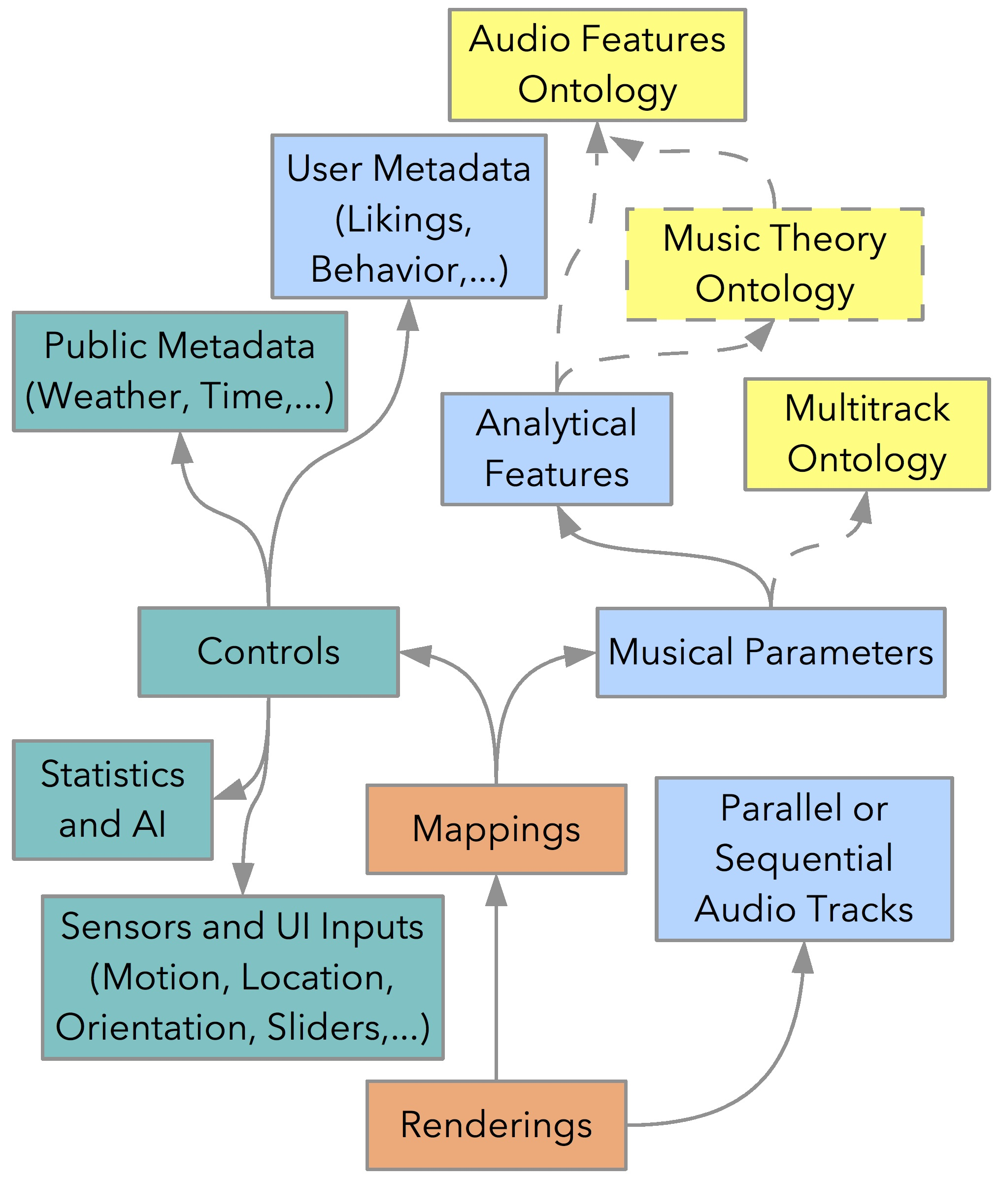
Semantic Player: A Smart Mobile Audio Player
Based on Ontological Metadata
Florian Thalmann, C4DM, QML
Plays back groups of tracks (Dynamic Music Objects) differently each time
Consumer-oriented, producer/distributor-defined
Mobile Audio Ontology (see image) defines renderings of DMOs
Currently allows for mappings of various inputs to musical parameters
Platform independent with Ionic (AngularJS, Cordova), Web Audio API, Rdfstore-js

Slide 7
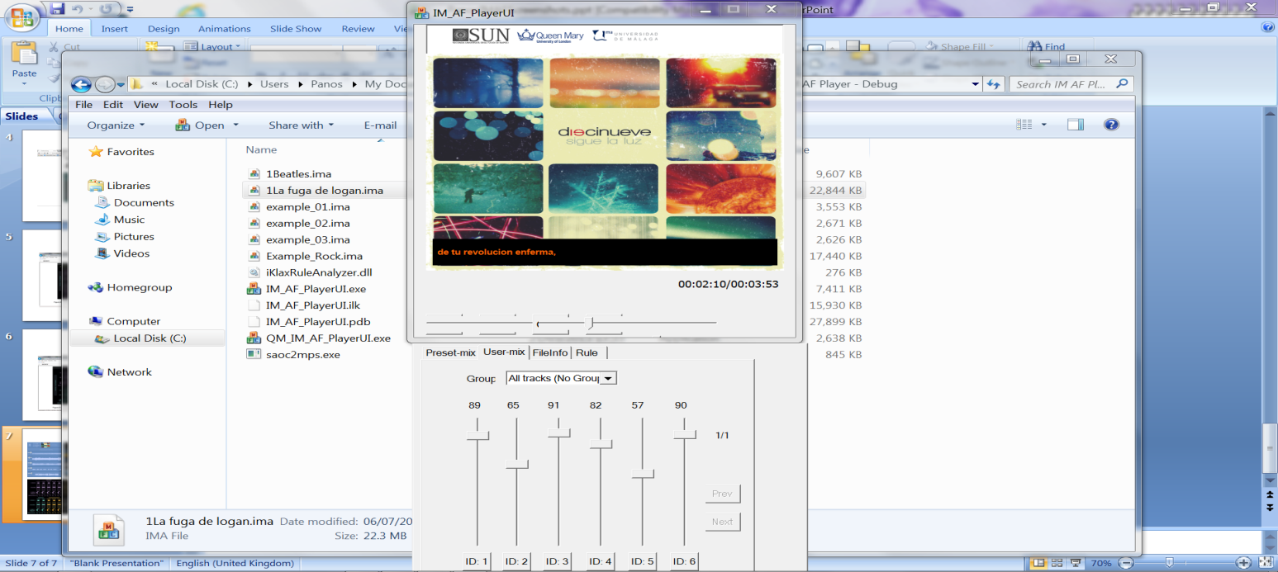
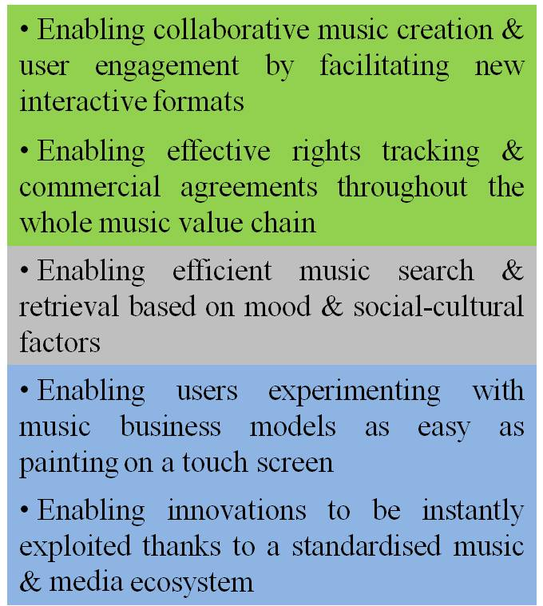
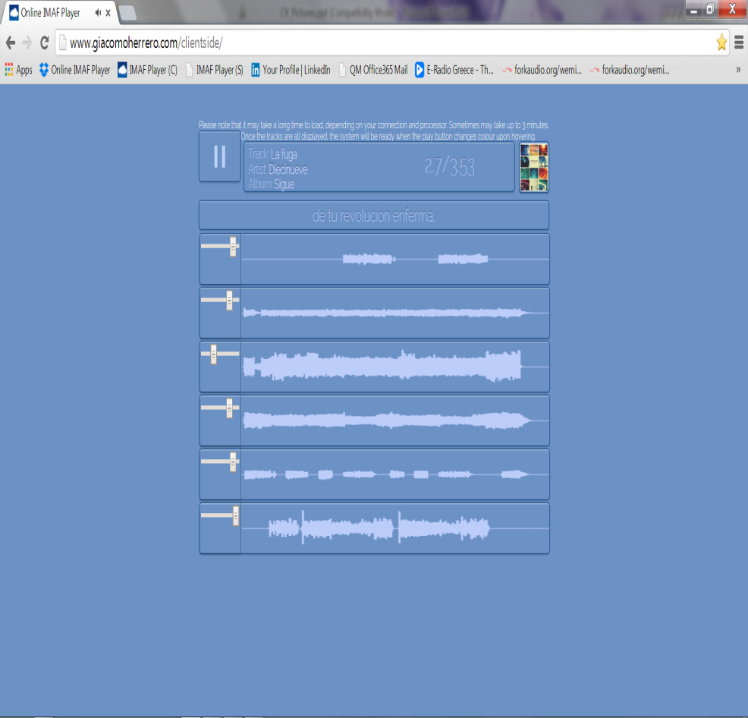
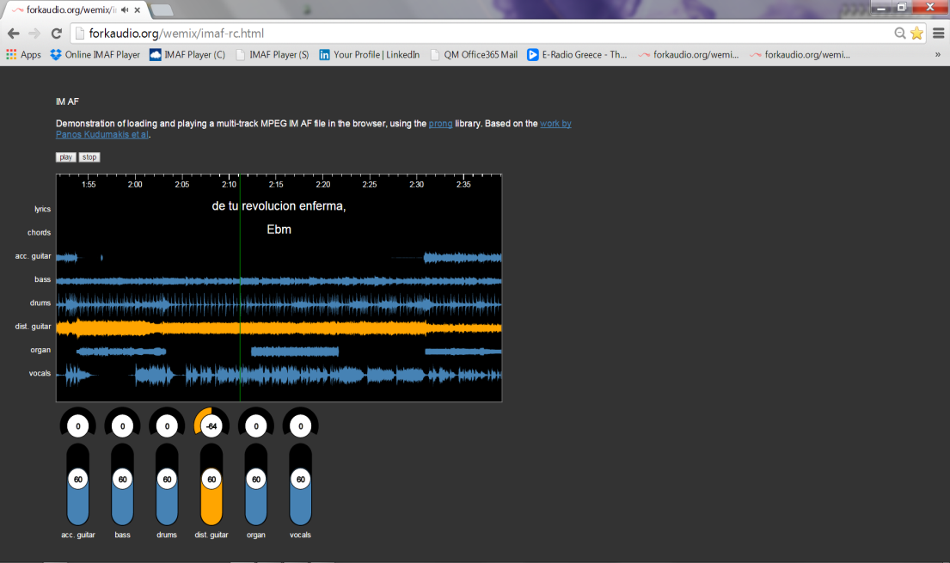
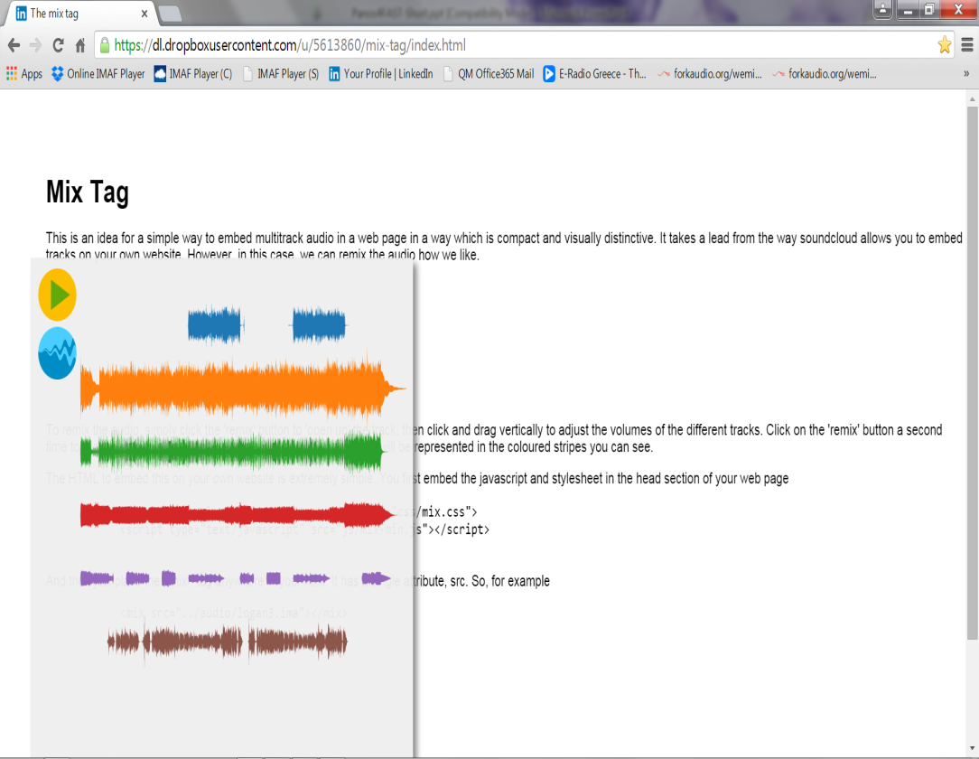
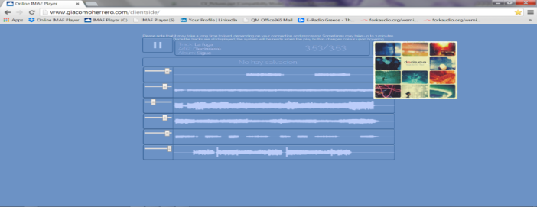
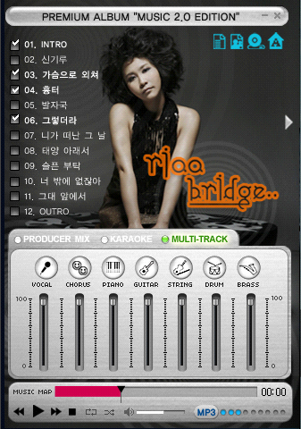
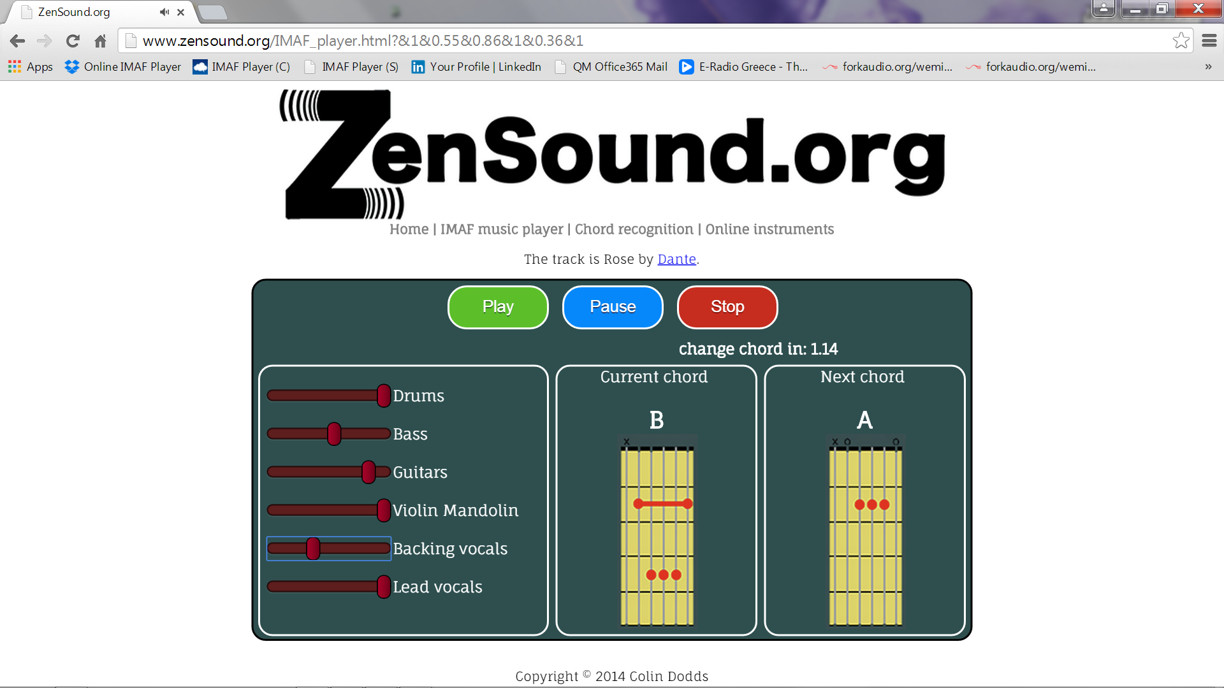
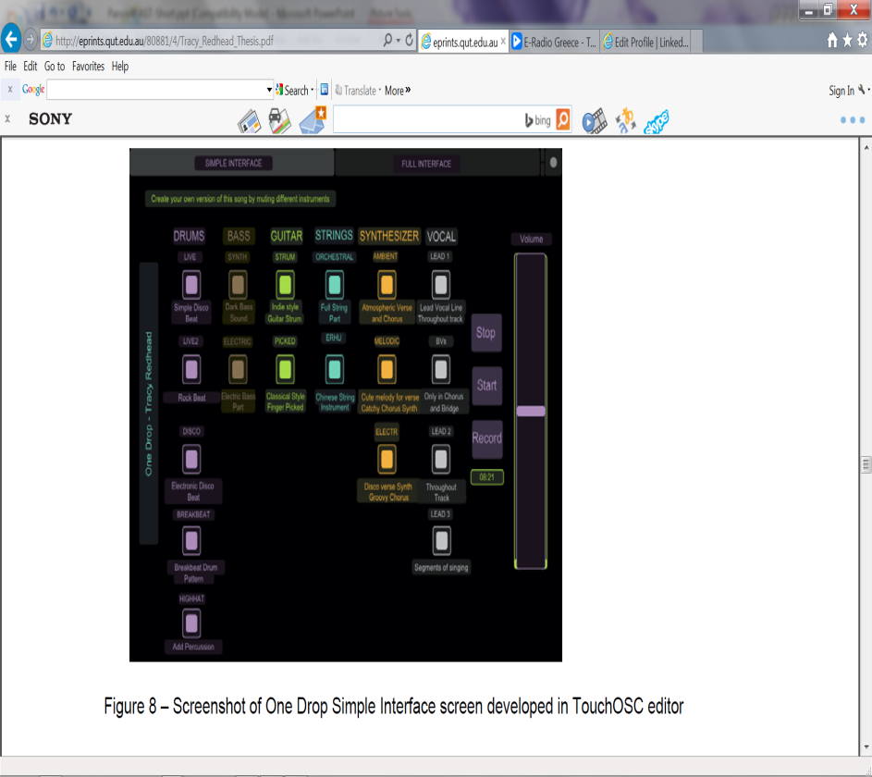
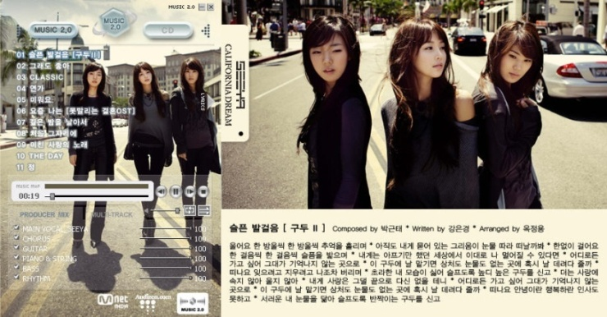
Enabling interactive & interoperable semantic music apps
Mariano Mora-Mcginity, Thomas Wilmering, Allo Alik, George Fazekas, Panos Kudumakis, Mark Sandler
IM AF
MVCO
C4DM
MPEG-M
MPEG-M

Slide 8
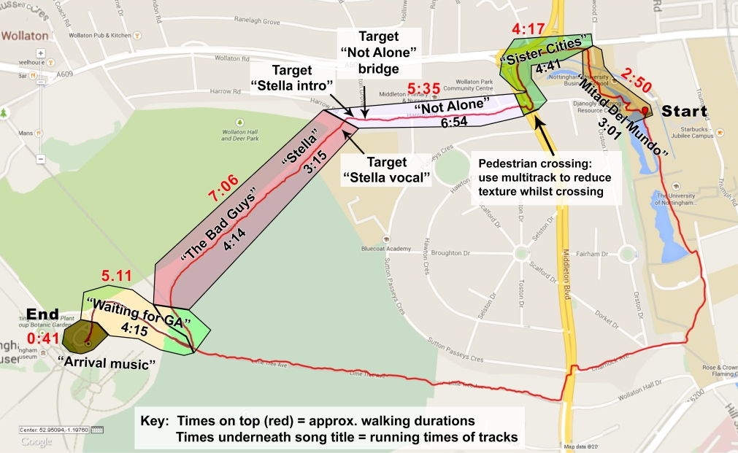



Mobile music demonstrator
Chris Greenhalgh, Adrian Hazzard, Sean McGrath
daoPlayer - a prototype adaptive music player app to explore the characteristics, opportunities and challenges of creating mobile soundtracks.
daoPlayer 1.17 (Android)
  - GPS driven (i.e. fixed transition points and real-time tracking and updates)
  - Multi-track (i.e. onset , offset, volume)
  - Audio track section data used for dynamic re-arrangement of single or multi-track audio
  Experimental study (May – July 2015)
    Circular walk
    Music tracks adapt for one half - fixed playlist on other
    Adaptations: sectional and rearranging and multi-track remixing of songs to suit physical structure of walk
    Currently scripting / testing – participants
    and data capture throughout June

Slide 11
Ethnographic themes in music production and consumption -
Nottingham MRL
communication
composition
collaboration
content management & planning
performance
production

Slide 12

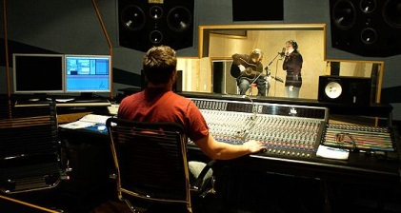
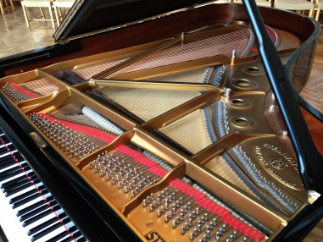
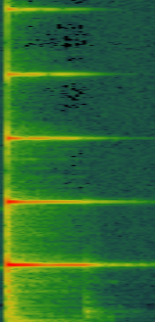

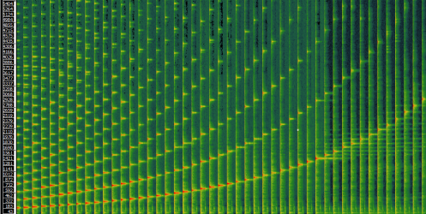
Music Transcription in the Studio
Concept: Exploiting Strong Prior Knowledge Available
Production specific:
  Acoustic properties of recording environment (microphones, amplifiers, room)
Instrument-class specific
  Signal models adapted to the specific sound production process of a class of instruments
Instance specific
  Acoustical prior knowledge about the specific instrument or performance
  (e.g. learning from individual notes and performance sub-parts)
Result: Drastically increased model accuracy

Slide 16
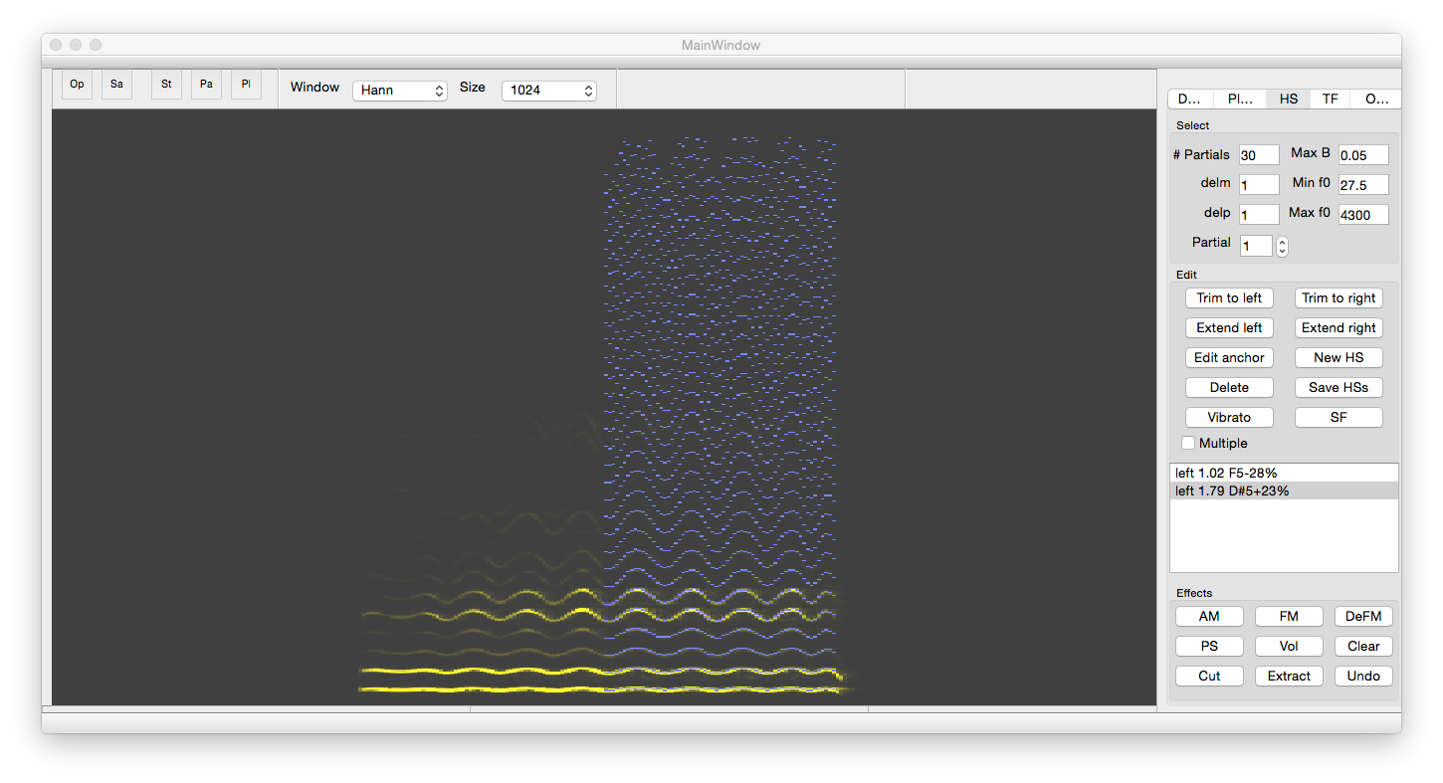
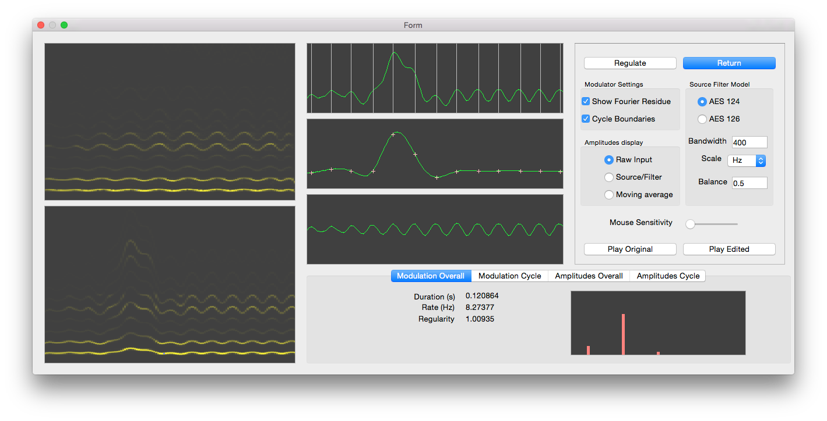

Harmonic Visualiser
Quasi-harmonic Analysis
Temporal Tracking with variable pitch
Harmonic sinusoid note representation
Audio editing
Modulations and Transformations
Vibrato

