Slide 1
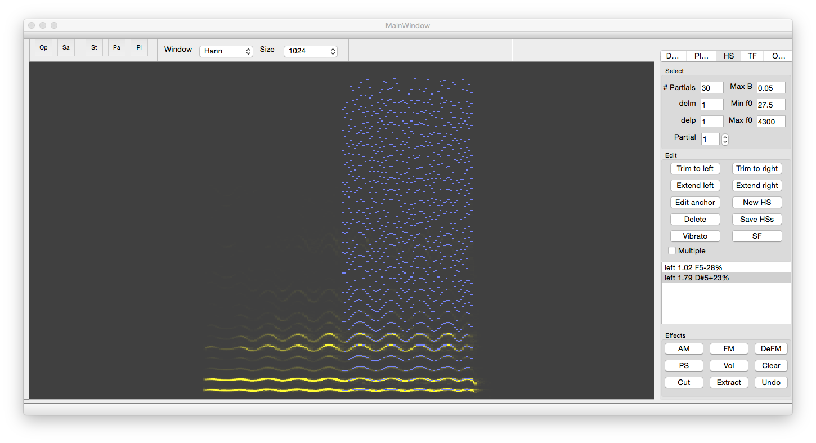
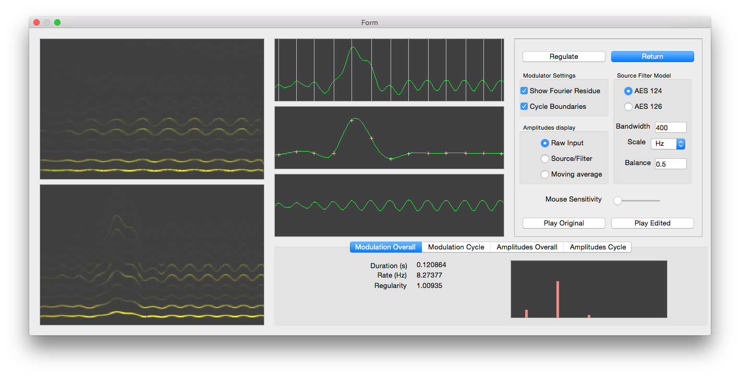
Harmonic Visualiser
Quasi-harmonic Analysis
Temporal Tracking with variable pitch
Harmonic sinusoid note representation
Audio editing
Modulations and Transformations
Vibrato

