Slide 1
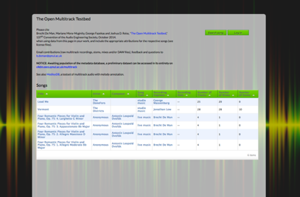
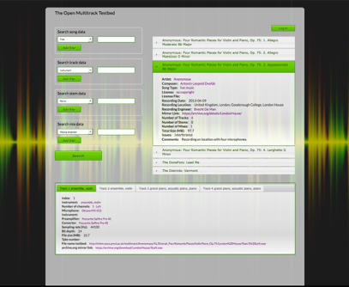
Multitrack testbed
Mariano Mora-McGinity, Brecht De Man, Görgy Fazekas, Queen Mary University
A database of semantically linked metadata about audio recordings
Users can input, search and browse linked data
Stores tracks from several databases
Faceted search and data display through various categories
Web application with user management to control access to data.

